Slide 1

Role of kinases MAP2K1, PDHK and NEK1 on Hedgehog Signaling Activation
Paige Halas
Atwood Lab Rotation Wrap Up
December 6, 2019

Slide 2
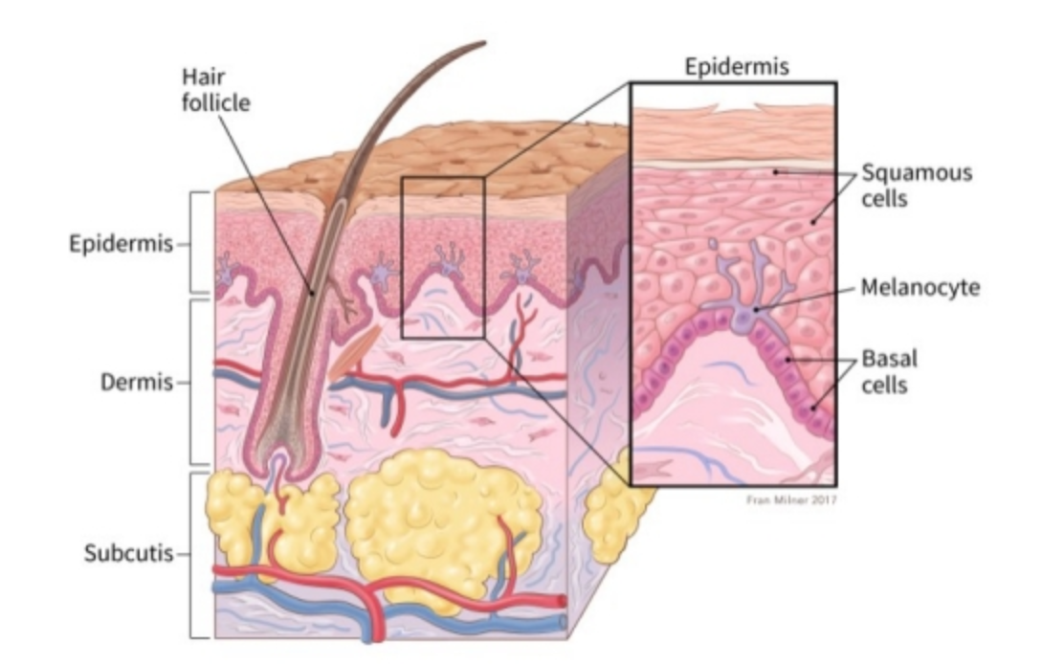
Basal Cell Carcinoma
Annual Skin Cancer Diagnosis in the US
American Cancer Society
Notes:
Basal Cell Carcinoma is the most prevalent skin cancer in the US with 4 million diagnosis a year. This cancer occurs in the basal layer which is the lowest layer of the epidermis.

Slide 3
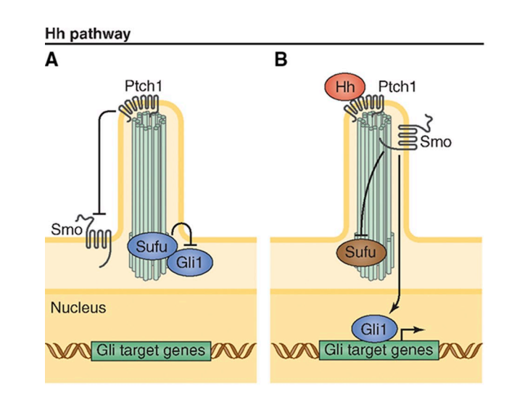
Hedgehog Signaling Pathway
Atwood et al., 2012
Notes:
BCC has been correlated with uncontrolled activation of the hedgehog signaling pathway which is critical in development in the primary cilia of a cell.
A. Inactive Hh pathway and B. active Hh pathway

Slide 4
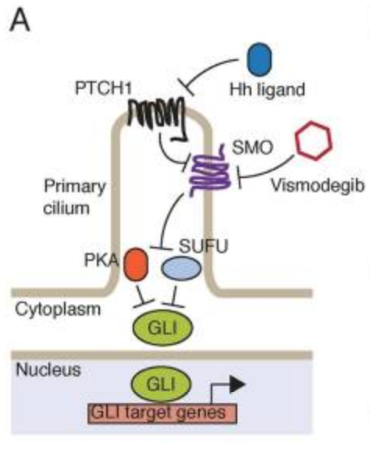
Inhibition of SMO to treat BCC
Sharpe et al., 2015

Slide 5
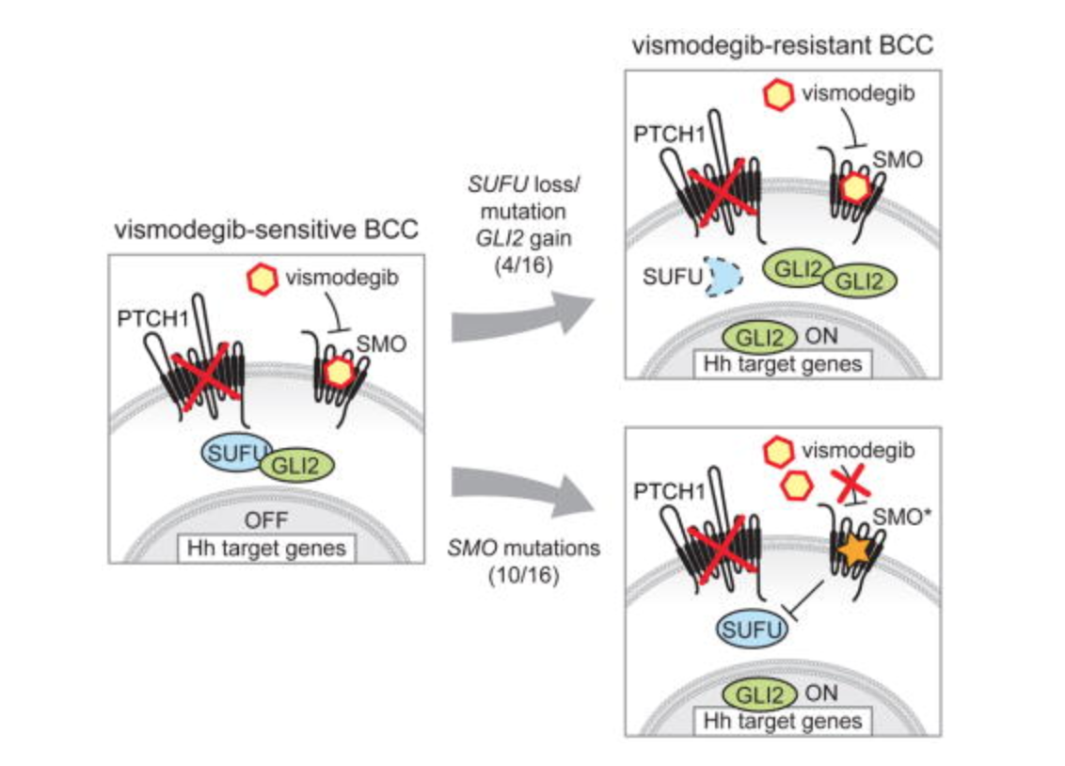
Inhibition of SMO to treat BCC
Sharpe et al., 2015

Slide 6
Inhibition of SMO to treat BCC
Kinase
Regulated
Sharpe et al., 2015

Slide 7
Kinases Active at Re-current GLI Mutations
Kinase | Significance | Inhibitor
Mitogen-Activated Protein Kinase 2 (MAP2K1/MEK1) | Melanoma and metastasis Stabilizes GLI and activates Hedgehog Signaling | Cobimetinib IC50 4.2 nM
Pyruvate Dehydrogenase Kinase (PDHK) | Regulates glycolysis Inhibition upregulates apoptosis | Dichloroacetic Acid IC50 81.03 mM
NIMA Related Kinase (NEK1) | Role in ciliogenesis Inhibition reduces GLI activation and Hedgehog Signaling | Zinc05007751 IC50 3.4 μM

Slide 8
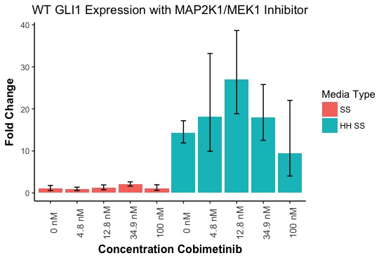
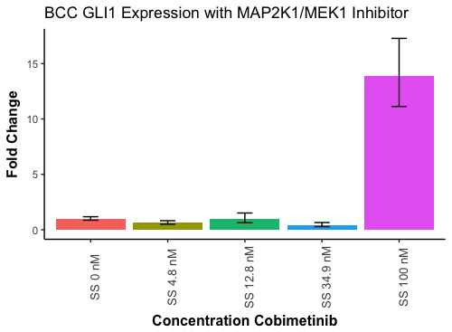
MAP2K1/MEK1 inhibition does not impact Hedgehog Signaling Activation

Slide 9
MAP2K1/MEK1 Affects Cell Proliferation at High Concentrations of Inhibitor

Slide 10
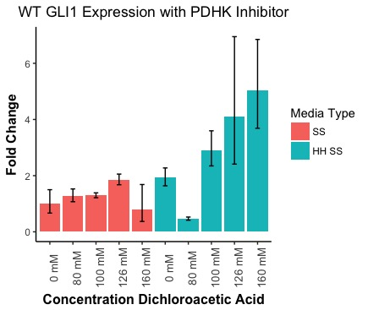
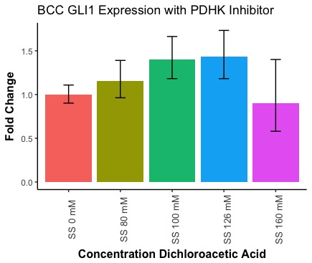
PDHK Inhibition by Dichloroacetic Acid does not activate Hedgehog Signaling

Slide 11
Treatment of BCC cells with PDHK inhibitor Dichloroacetic Acid does not affect cell survival

Slide 12
Zinc qPCR

Slide 13
Zinc Viability

Slide 14
Future Directions

